Slide 1


A METHODOLOGY TO SIMULATE TRAVELERS’ BEHAVIOR FOR MODAL CHOICE USING AGENT BASED MODELING
Mohammad Ahanchian
PostDoc
Energy System Analysis
moah@dtu.dk
Tanu Priya Uteng
Institute of Transport Economics (TØI)
tanu.PriyaUteng@toi.no

Slide 2
Main avenues for decarbonization of inland transport
Behavioral Changes
(e.g., Modal shift)
Technological Changes
(e.g., Fuel switch like EVs)
Decarbonization of inland transport
Notes:
The Danish government has engaged in the ambitious goal of becoming independent of fossil fuels by 2050

Slide 3
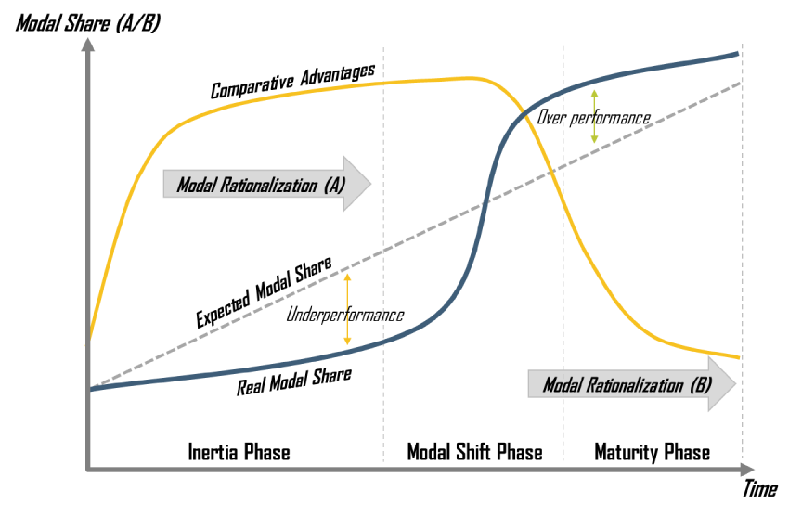
What is modal shift
cost,
time,
level of service
or reliability
Notes:
This figure describes briefly the concept of Modal Shift
A modal shift occurs when one mode has a comparative advantage in a similar market over another mode.
Comparative advantages can involve the difference in cost, time, level of service or reliability between two modes and depend on consumer choices and expectations.

Slide 4
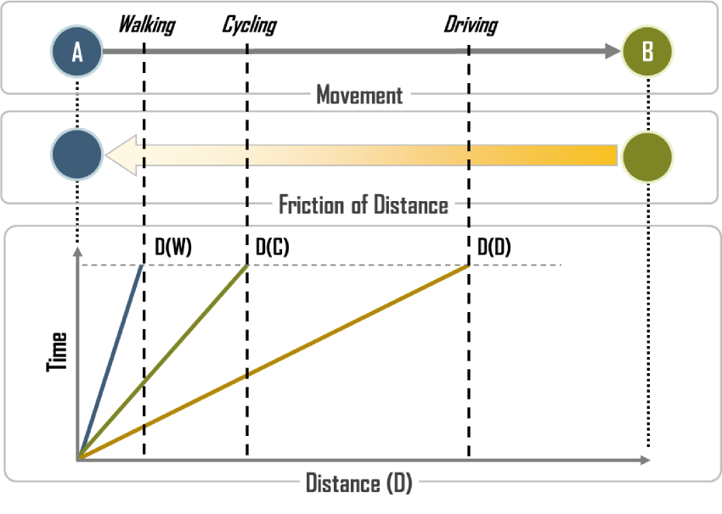
Dimensions of different modes
Travel Time
Travel Budget
Notes:
Differnet modes of transport have various dimensions.
The distance varies according to the mode used
For instance, given the same amount of time, a pedestrian may cross a distance walk, while a cyclist and an automobilist would cross a Distance Cycle and Drive respectively.

Slide 5
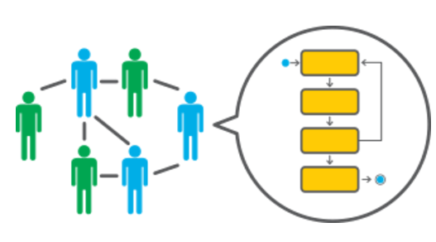
Agent Based Modeling in Modal Shift
Travelers are regarded as agents.
Agents don’t have interaction with each other. In TU Survey, there is no data about how people make decision. However, there are the historical data that how people accomplished the trip.
Make decision according to decision rules in the traffic system.
AnyLogic tool using JAVA programming.

Slide 6
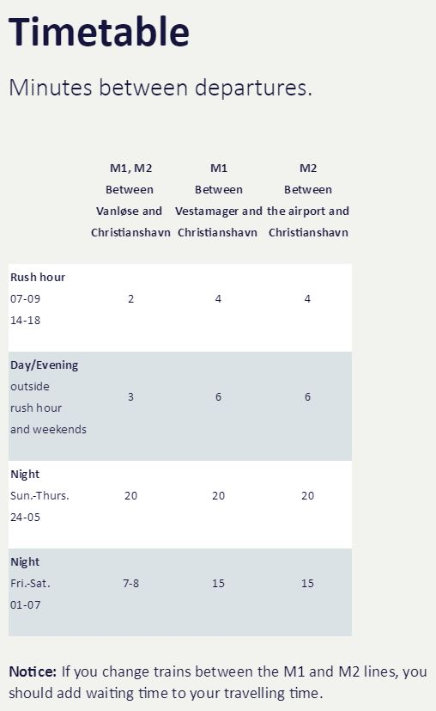
Layers of this study

Slide 7
Data gathering and model structure
Notes:
The Danish National Travel Survey (TU), which is an interview survey that documented the travel behavior of the Danish population, is used to capture the socio-economic characteristics of commuters.
The annual demand is taken from Danish national transport model (LTM) which is a newly developed four-stage simulation transport model of Denmark.

Slide 8
Generate random agents (Monte Carlo)

Slide 9
Monte Carlo Simulation
The Monte Carlo simulation will replicate 30 times in both approaches to show the robustness of the model
Notes:
Since the model contains random processes, as suggested by Sopha et al., (2011) multiple runs (replications) of simulations using identical parameters and initial conditions are necessary to determine whether the results of a simulation run are representative.
Therefore, 30 replications were performed.
The mean values of 30 replications and corresponding error bars will be reported.

Slide 10
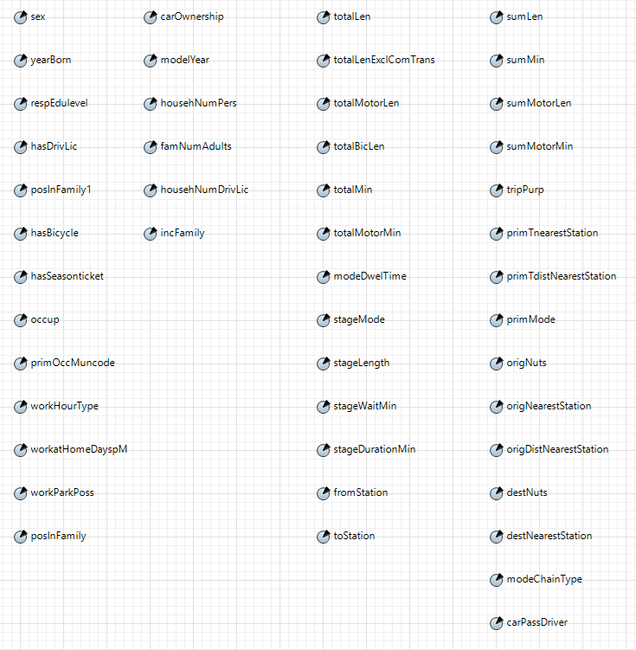
Assign the attributes of responders to Agents
Family Level
Trip
Individual Level

Slide 11
Decision making algorithm on mode of transport
The decision rules are based on
  Tangible and intangible costs
  Availibility of infrastructure
  Access to bike/car
  Based on these rules, the agents decide on Mode of Transport

Slide 12

Non-Motorized (NMT)
$C_{w}^{Intangible}={VoT}_{IC}×\left(L_{w}^{Trip}/S_{w,UT,age}^{Average}\right)$
$C_{b}^{Tangible}=L_{b}^{Trip}×C_{b}^{Maintenance}$
$$C_{b}^{Intangible}={VoT}_{IC}×\left(L_{b}^{Trip}/S_{b,UT,age}^{Average}\right)$$
  VoT (DKK/Min) from LTM varies across trip purpose (e.g., business vs. other purposes) and household income.

Slide 13

Private car
$$C_{p}^{Tangible}=L_{p}^{Trip}×(C_{a}^{Fuel}+C_{a}^{Tire}+C_{a}^{Maintenance}+C_{a}^{Insurance}+C_{a}^{Tax}+C_{a}^{other})/M_{a}$$
$$C_{a}^{Fuel}=M_{a,p}×FP/{FE}_{p}$$
$$C_{p}^{Intangible}={VoT}_{IC}×\left(T_{p}^{InVehicle}+T_{p,UT}^{Congestion}×{Penalty}_{p,TP}^{Congestion}\right)$$
$$T_{p}^{InVehicle}=L_{p}^{Trip}/S_{p,UT}^{Average}$$
FDM (2017). Billigere at køre efter rundstykker.
The choice of private car as a driver is conditional on having a driver’s license and car. Furthermore, the choice of private car as a passenger is conditional on having a car.
CongestionTime extracted from LTM and changes across zones
Penalty parameters are extracted from LTM and change across trip purpose

Slide 14

Public
$$C_{pu}^{Intangible}={VoT}_{IC}×\left(T_{pu}^{InVehicle}+{(T}_{pu,UT}^{Wait}×{Penalty}_{pu}^{Wait}{)+{(T}_{pu,UT}^{ACC/EGR}×Penalty}_{pu}^{ACC/EGR})\right)$$
$$T_{pu}^{InVehicle}=L_{pu}^{Trip}/S_{pu,UT}^{Average}$$
Total Cost
$$C_{m}^{Total}=C_{m}^{Tangible}+C_{m}^{Intangible}$$
$$U_{ni}={\left(C_{ni}^{Total}\right)}^{−1}$$
Individual n will choose alternative _{i*} if and only if:$U_{ni^{∗}}≥U_{ni}, ∀i∈D_{n} and i≠i^{∗}$
Notes:
The decision criterions are formulated based on monetary units using utility function approach. Meaning that Individual n will choose alternative _{i*} if and only if the utility function of $i^{∗}$ is greater than i.

Slide 15
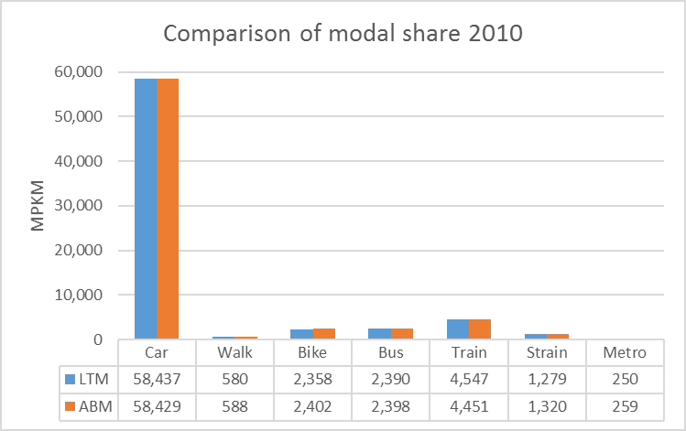
Calibration

Slide 16
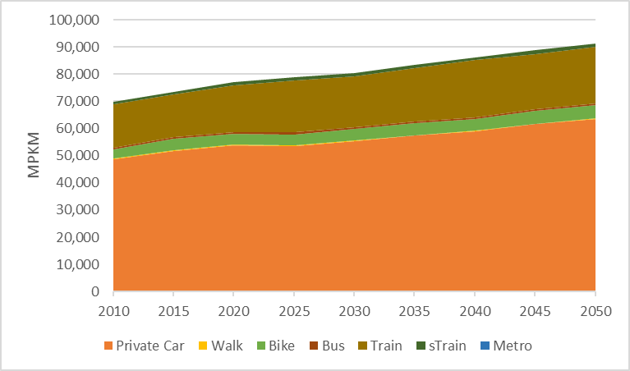
Results (BAU)
The results will predict commuter travel behavior and transportation system utilization in response to changes in fuel/ticket price, infrastructure (waiting/Acc/Egress time).

Slide 17
THANK YOU FOR YOUR ATTENTION
Questions?
Comments!
moah@dtu.dk
tanu.PriyaUteng@toi.no
Notes:
In practice, the agent-based model can be used to analyze the result of travel mode shift in response to different kinds of policies and strategies such as gasoline tax, road pricing, parking fee, bus and metro fare, and vehicle usage restriction.

