Slide 1


A dynamic Bayesian network approach to forecast short-term urban rail passenger flows with incomplete data
Jérémy Roos • Gérald Gavin • Stéphane Bonnevay
European Transport Conference 2016, Barcelona

Slide 2
Contents
1. Context and problematic
2. Modelling approach
3. Large-scale experiment
4. Conclusion and references

Slide 3
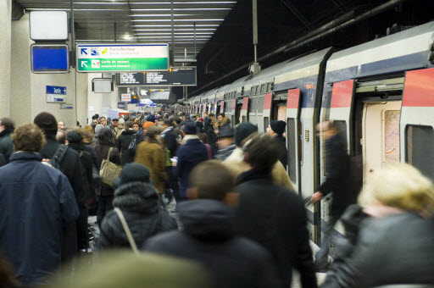
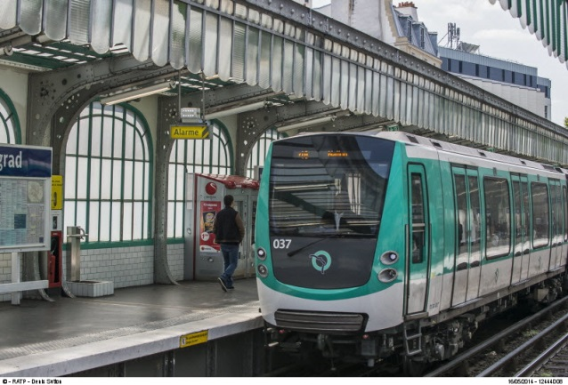
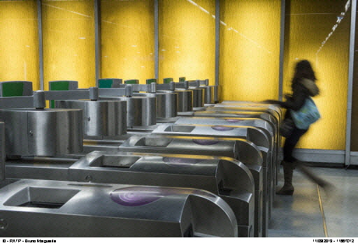
RATP
1. Context and problematic
Main public transport operator in the Paris region
  16 metro lines
  Sections of 2 RER lines (commuter rail)
  8 tramway lines
  More than 350 bus lines
  3 billions travels per year

Slide 4
Industrial context
1. Context and problematic
Current models: assessment of the long-term effects of infrastructure/transport policy changes
  Models not designed for short-term forecasting
  Unexpected/non-recurrent events not taken into account:
    Service disruptions
    Unplanned closures of stations
    Crowd-attracting events
    …
Diversity of data sources
  Diversity still untapped → partial view of the mobility
  Failures/lack of collection systems → incompleteness

Slide 5
Problematic
1. Context and problematic
Harnessing of the diversity of data to forecast the short-term passenger flows
  Many applications in transport system management:
    Operation planning
    Passenger flow regulation
    Passenger information
    Analysis of travel bahaviour
    …
  Various methods in the literature but few applications to public transport networks
Necessity to forecast with missing data
  Few methods proposed in a real-time setting

Slide 6
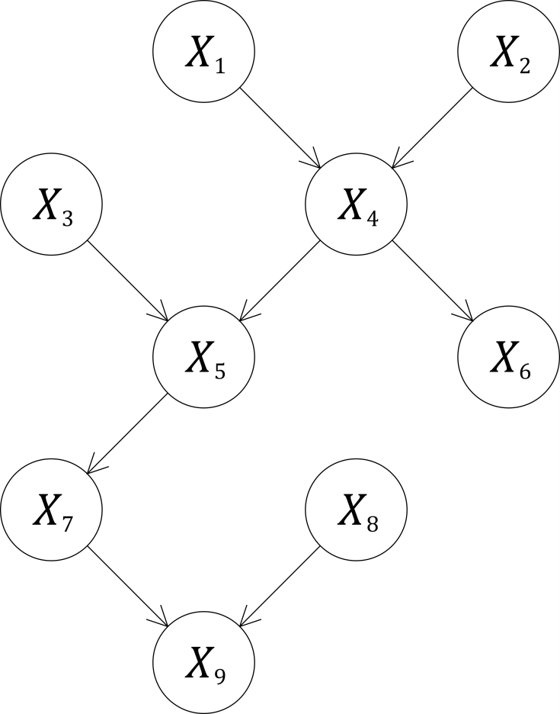
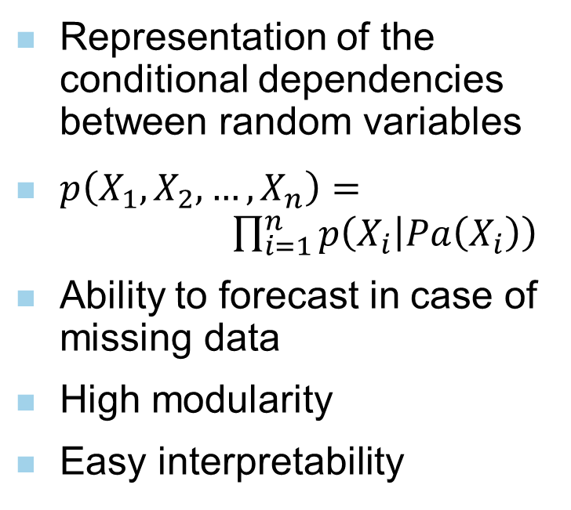
Bayesian networks
2. Modelling approach
Representation of the conditional dependencies between random variables
$p\left(X_{1}, X_{2},…,X_{n}\right)= \prod_{i=1}^{n}{p\left(X_{i} | Pa\left(X_{i}\right)\right)}$
Ability to forecast in case of missing data
High modularity
Easy interpretability

Slide 7
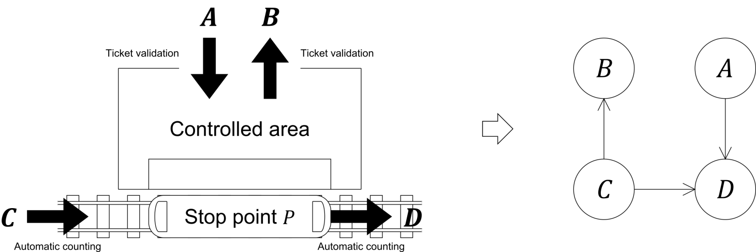
From transport to Bayesian network
2. Modelling approach
Causal relationships between the upstream and downstream flows → derivation of the structure from the transport network

Slide 8
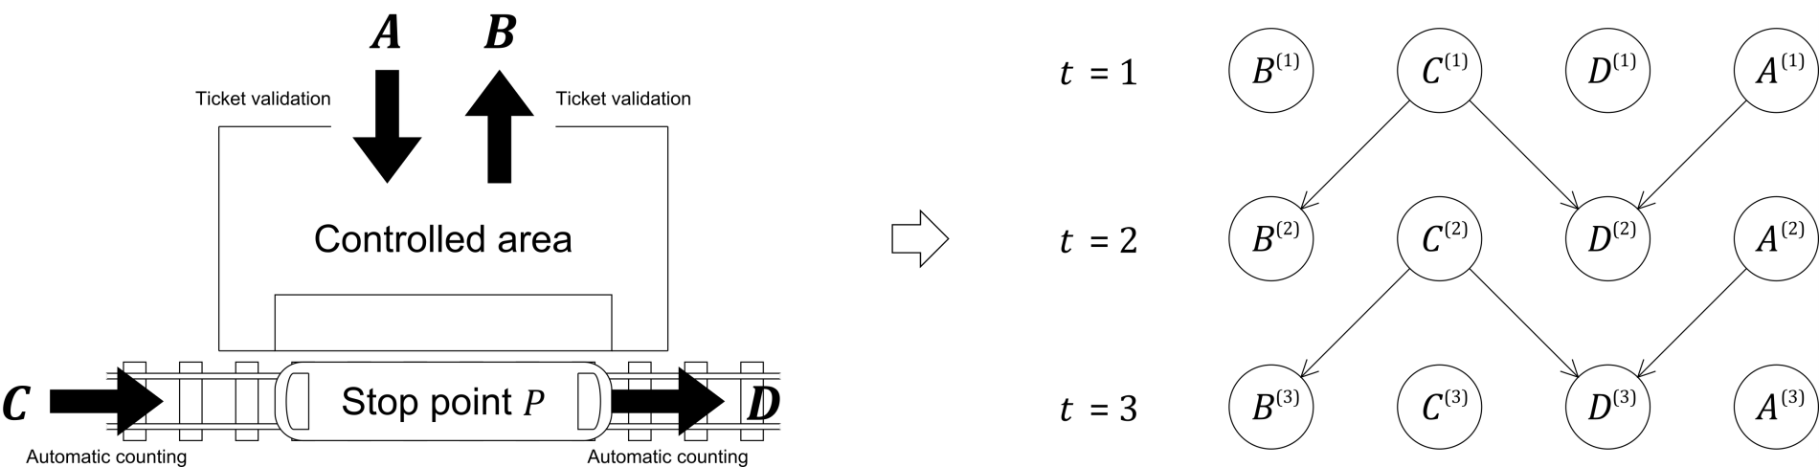
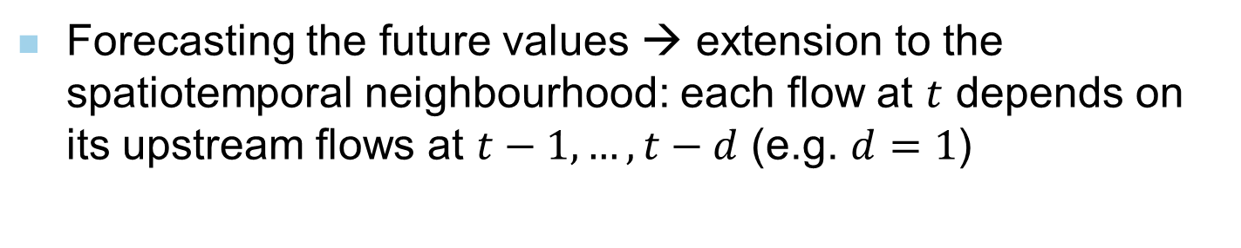
Extension to dynamic Bayesian networks
2. Modelling approach
Forecasting the future values → extension to the spatiotemporal neighbourhood: each flow at $t$ depends on its upstream flows at $t−1,…,t−d$ (e.g. $d=1$)

Slide 9
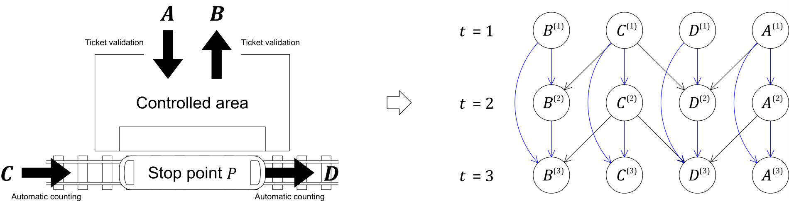

Extension to dynamic Bayesian networks
2. Modelling approach
Consideration of the trend: each flow at $t$ depends on its values at $t−1,…,t−m$ (e.g. $m=2$)

Slide 10
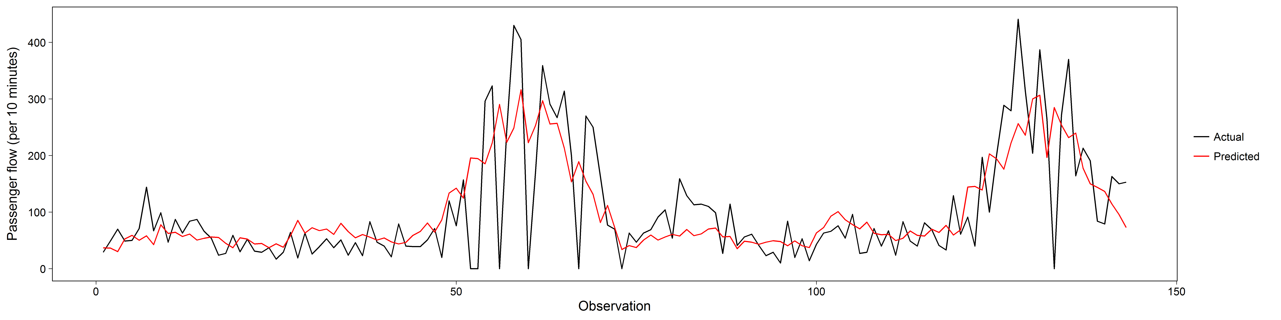
Integration of the transport service
2. Modelling approach
Relationship between the flows and the transport service
  Inability to fit the large fluctuations without transport service data (e.g. boarding flow in Nanterre-Préfecture station)

Slide 11
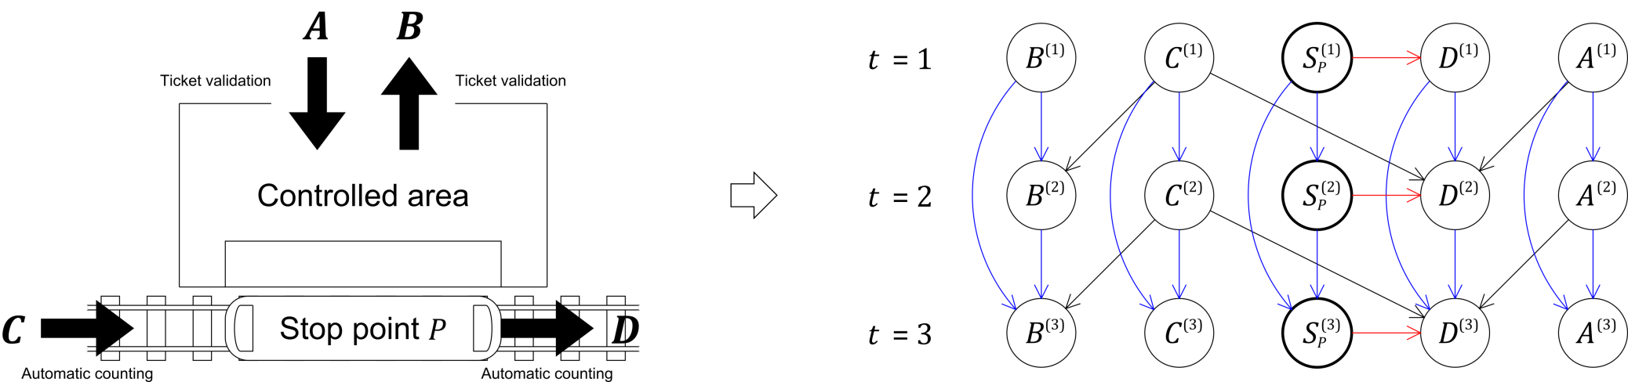
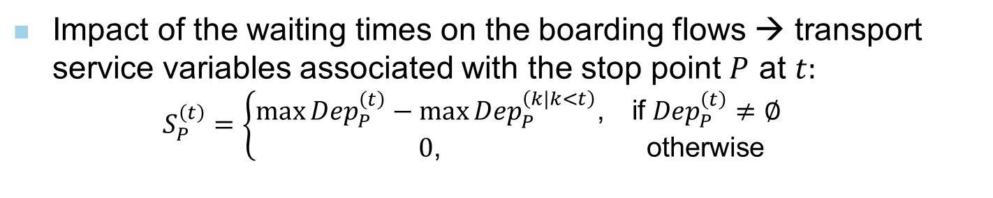
Integration of the transport service
2. Modelling approach
Impact of the waiting times on the boarding flows → transport service variables associated with the stop point $P$ at $t:$
  $$S_{P}^{\left(t\right)}=\left\{\begin{matrix}\max{{Dep}_{P}^{\left(t\right)}}−\max{{Dep}_{P}^{\left(k|k<t\right)}\text{,}} & \text{if} {Dep}_{P}^{\left(t\right)}≠∅ \\ 0\text{,} & \text{otherwise}\end{matrix}\right.$$

Slide 12
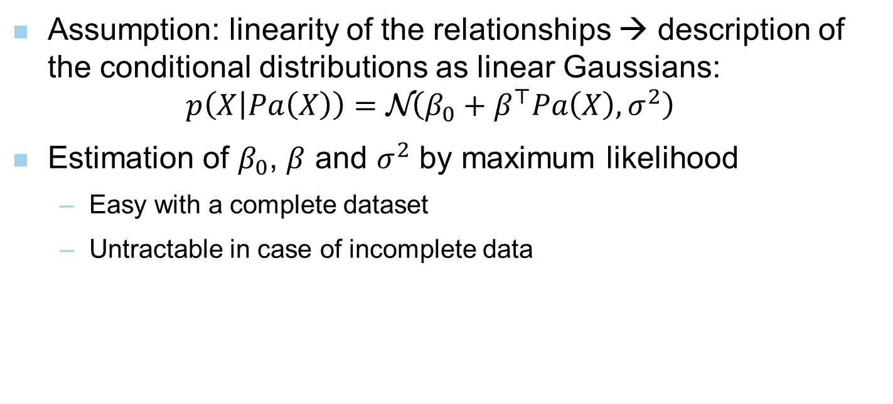
Conditional probability distributions
2. Modelling approach
Assumption: linearity of the relationships → description of the conditional distributions as linear Gaussians:
$p\left(X | Pa\left(X\right)\right)=\text{N}\left(β_{0}+β^{⊤}Pa\left(X\right),σ^{2}\right)$
Estimation of $β_{0}$, $β$ and $σ^{2}$ by maximum likelihood
  Easy with a complete dataset
  Untractable in case of incomplete data

Slide 13
Learning and inference
2. Modelling approach
Expectation-maximization (EM) algorithm: iterative method for finding the maximum likelihood estimate with missing data
Reduction of the number of arcs → extension of the EM algorithm to its structural version
  Lower computational complexity
  Lower risk of overfitting
Short-term prediction: inference problem
  Exact methods time-consuming
  Approximate methods better suited for real-time predictions (e.g. bootstrap filter)

Slide 14
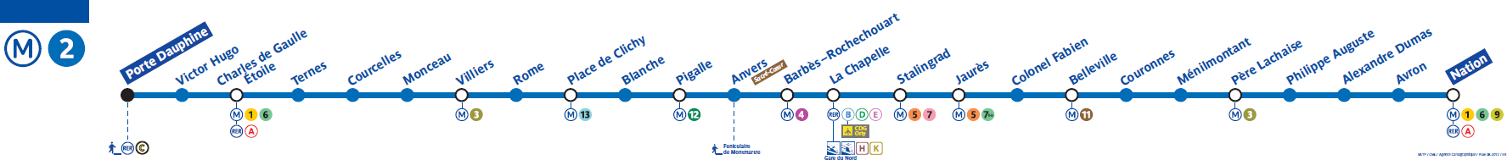
Input data
3. Large-scale experiment
Stations served by Paris metro line 2
3 types of data:
  Ticket validation (35 flows)
  Automatic counts by on-board weighing systems (60 flows)
  Transport service (114 variables)
33 weekdays of March and April 2015, between 7.30 and 9.30 am, per 2 minutes
Missing data rate: 4.8 %

Slide 15
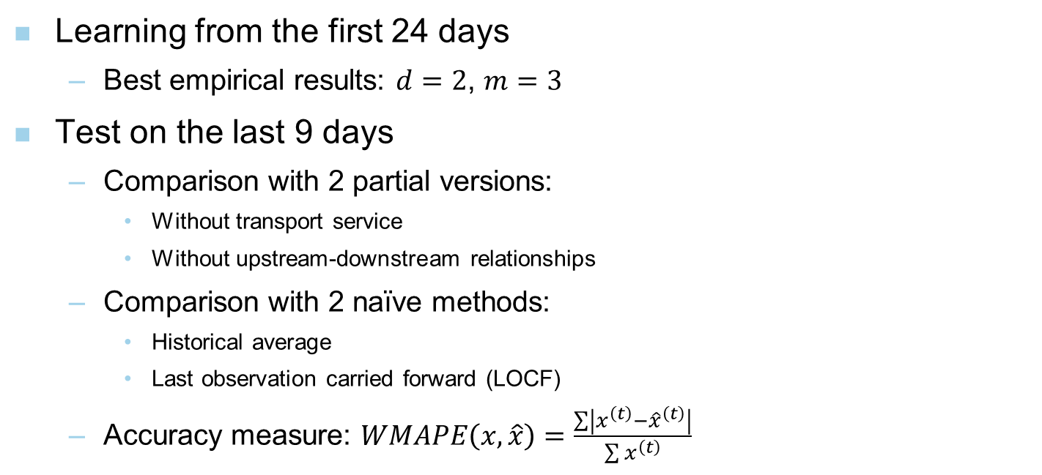
Experimental method
3. Large-scale experiment
Learning from the first 24 days
  Best empirical results: $d=2$, $m=3$
Test on the last 9 days
  Comparison with 2 partial versions:
    Without transport service
    Without upstream-downstream relationships
  Comparison with 2 naïve methods:
    Historical average
    Last observation carried forward (LOCF)
  Accuracy measure: $WMAPE\left(x,\hat{x}\right)=\frac{\sum{\left|x^{\left(t\right)}−{\hat{x}}^{\left(t\right)}\right|}}{\sum{x^{\left(t\right)}}}$

Slide 16
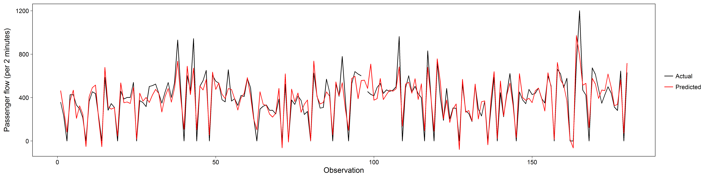
Forecasting results
3. Large-scale experiment
High contribution of the transport service, especially for the train departure flows (e.g. from Blanche station to Place de Clichy station)
Significant improvement when integrating the upstream-downstream relationships

Slide 17
Forecasting results
3. Large-scale experiment
Overall superiority of the dynamic Bayesian network approach due to the train departure flows
Superiority of historical average for the flows from public to controlled areas
  Flows located at the margins → cannot exploit the full potential of the model
  Regularity of the flows from day to day

Slide 18
Conclusion
4. Conclusion and references
Overall effectiveness of the dynamic Bayesian network approach
  Ability to forecast with missing data
  Key role of the transport service
  Necessity to improve the model for the walking flows
Assumption of linearity questionable → what about more sophisticated distributions (e.g. Gaussian mixture models) ?
Stationarity of the structure and the parameters → effectiveness in case of major disruptions ?
High modularity → possibility to incorporate new data sources:
  Temporal factors: trend, month of the year, day of the week…
  External features: weather conditions, sporting or cultural events…

Slide 19
References
4. Conclusion and references
Haworth, J. (2014) Spatio-temporal forecasting of network data, Doctoral dissertation, University College London.
Friedman, N., Murphy, K., Russel, S. (1998) Learning the Structure of Dynamic Probabilistic Networks, Proceedings of the 14th Conference on Uncertainty in Artificial Intelligence, Madison, 139-147.
Kanazawa, K., Koller, D., Russel, S. (1995) Stochastic simulation algorithms for dynamic probabilistic networks, Proceedings of the 11th Conference on Uncertainty in Artificial Intelligence, Montreal, 346-351.
Koller, D., Friedman, N. (2009) Probabilistic Graphical Models: Principles and Techniques, The MIT Press, Cambridge.
Sun, S., Zhang, C., Yu, G. (2006) A Bayesian Network Approach to Traffic Flow Forecasting, IEEE Transactions on Intelligent Transportation Systems, 7(1), 124-132.

