Slide 1
SCBA road pricing in the Netherlands
CPB Netherlands Bureau for Economic Policy Analysis
CPB: Annemiek Verrips
Willemijn Weijschede
Peter Zwaneveld Arne Brouwers
PBL: Hans Hilbers
Jordy van Meerkerk

Slide 2
SCBA of road pricing
Why?
Political parties consider road pricing as an important instrument to improve accessibility
European Commission actively supports road pricing policies
Most recent CBA in the Netherlands dates from 2007
  Congestion has decreased
  Vehicles more efficient
  New pricing systems
  New version of the Dutch National Transport Model

Slide 3
Pricing policies considered
  Flat rate charged on all roads 7 ct/km
  Congestion charge 11 ct/km on highly congested roads
  Flat rate (7 ct) and congestion charge (11 ct)
  Flat rate during peak-hours central Netherlands 5 ct/km

Slide 4
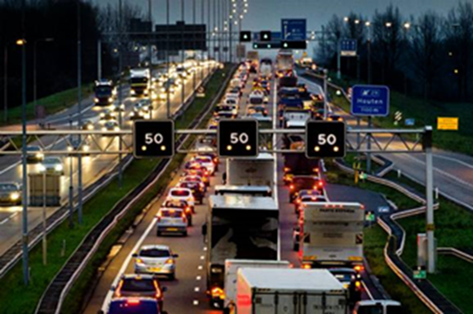
Pricing systems
Box with GPS function
Odometer
Simple box
Registration via the vehicle registration/number plate
DSRC system (with a tag in the car)
Smart vignette

Slide 5

Assumptions
Baseline scenario: no additional road capacity
Pricing policies apply to all passenger vehicles from 2020-2050
Dutch drivers are compensated with a reduction in existing car taxes

Slide 6


Baseline: two socio-economic long-term scenario’s
Global Economy (GE)
  High economic growth
  Large population
Regional Communities (RC)
  Low economic growth
  Small population

Slide 7
Baseline: Car use and congestion

Slide 8
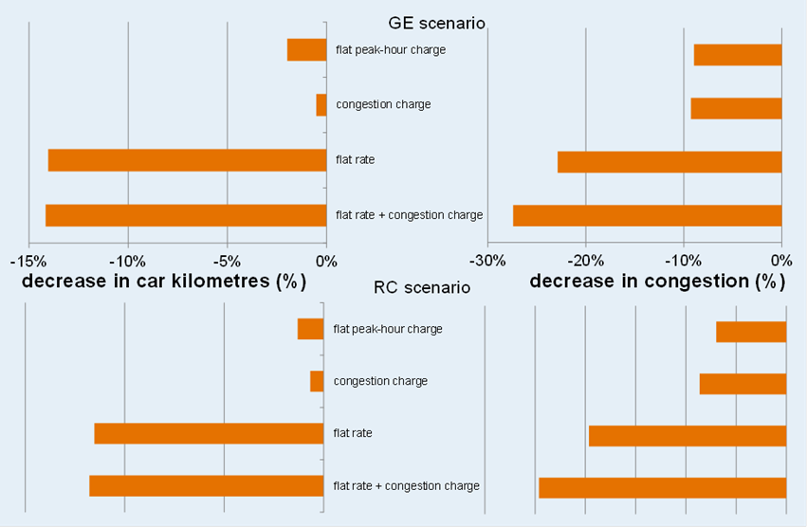
Traffic implications in 2020

Slide 9
Social Costs & Social Benefits
Drop in demand
Less tax revenues (excise duties)
Indirect effects (agglomeration economies)
Time administration
Travel time & reliability
External effects (air, noise, safety)
Indirect effects (agglomeration economies)
Road maintenance
More profitable PT exploitation (less subsidy)

Slide 10
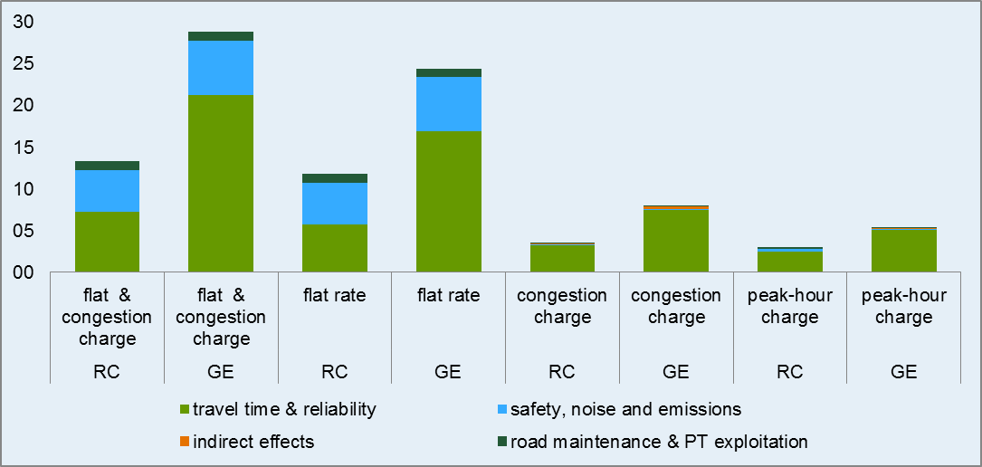
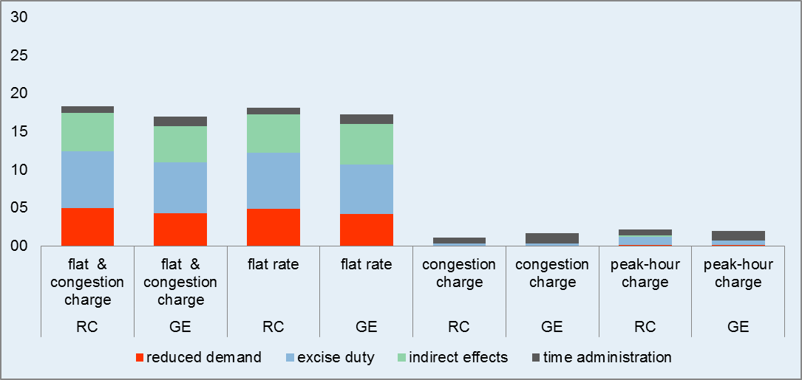

Slide 11
RC-scenario | Congestion charge | Peak-hour charge | Flat rate all roads | Flat rate & congestion charge
Benefits | +3.4 | +3.0 | +11.8 | +13.4
Costs | -1.1 | -2.2 | -18.1 | -18.3
System costs | -1.3 | -1.6 | -2.5 | -3.8
Net effect | +1.0 | -0.8 | -8.9 | -8.8
GE-scenario | Congestion charge | Peak-hour charge | Flat rate all roads | Flat rate & congestion charge
Benefits | +7.9 | +5.4 | +24.4 | +28.8
Costs | -1.7 | -2.0 | -17.3 | -17.0
System costs | -1.5 | -1.6 | -3.3 | -4.7
Net effect | +4.7 | +1.8 | +3.7 | +6.9

Slide 12
Additional Findings:
Differentiated congestion charge

Slide 13
Additional Findings:
Different height of the flat rate

Slide 14


Other Findings
Postponement improves the results
Pricing together with infrastructure investments lead to a lower impact

Slide 15
Conclusions
Congestion charge socially beneficial at both high and low economic growth, but difficult to implement
A more standard peak-hour charge only beneficial at high economic growth
A flat rate is only profitable if the levels of congestion are more than double the current levels in the Netherlands
Place/time differentiated rates improves the results
Postponement improves the results

